Slide 1
Thank- you for your Support!! *Each product has a web link for ordering ☺
BCS Entrepreneurship Fair, 2021

Slide 2
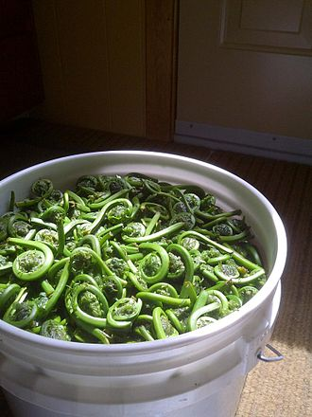
Jack’s Fiddleheads (cleaned) $3/per pound $9/three pounds $15/five pounds
https://anglophonewest.schoolcashonline.com/Fee/Details/24645/176/False/True

Slide 3
Art by Amelia Soothing Seascapes https://anglophonewest.schoolcashonline.com/Fee/Details/24861/176/False/True $5.00 ea. 10x14 inches 15 available

Slide 4
Maisie’s Macrame keychains https://anglophonewest.schoolcashonline.com/Fee/Details/24866/176/False/True 8 inches long 20 available (10 each colour) $5.00 each *available in taupe or grey*

Slide 5
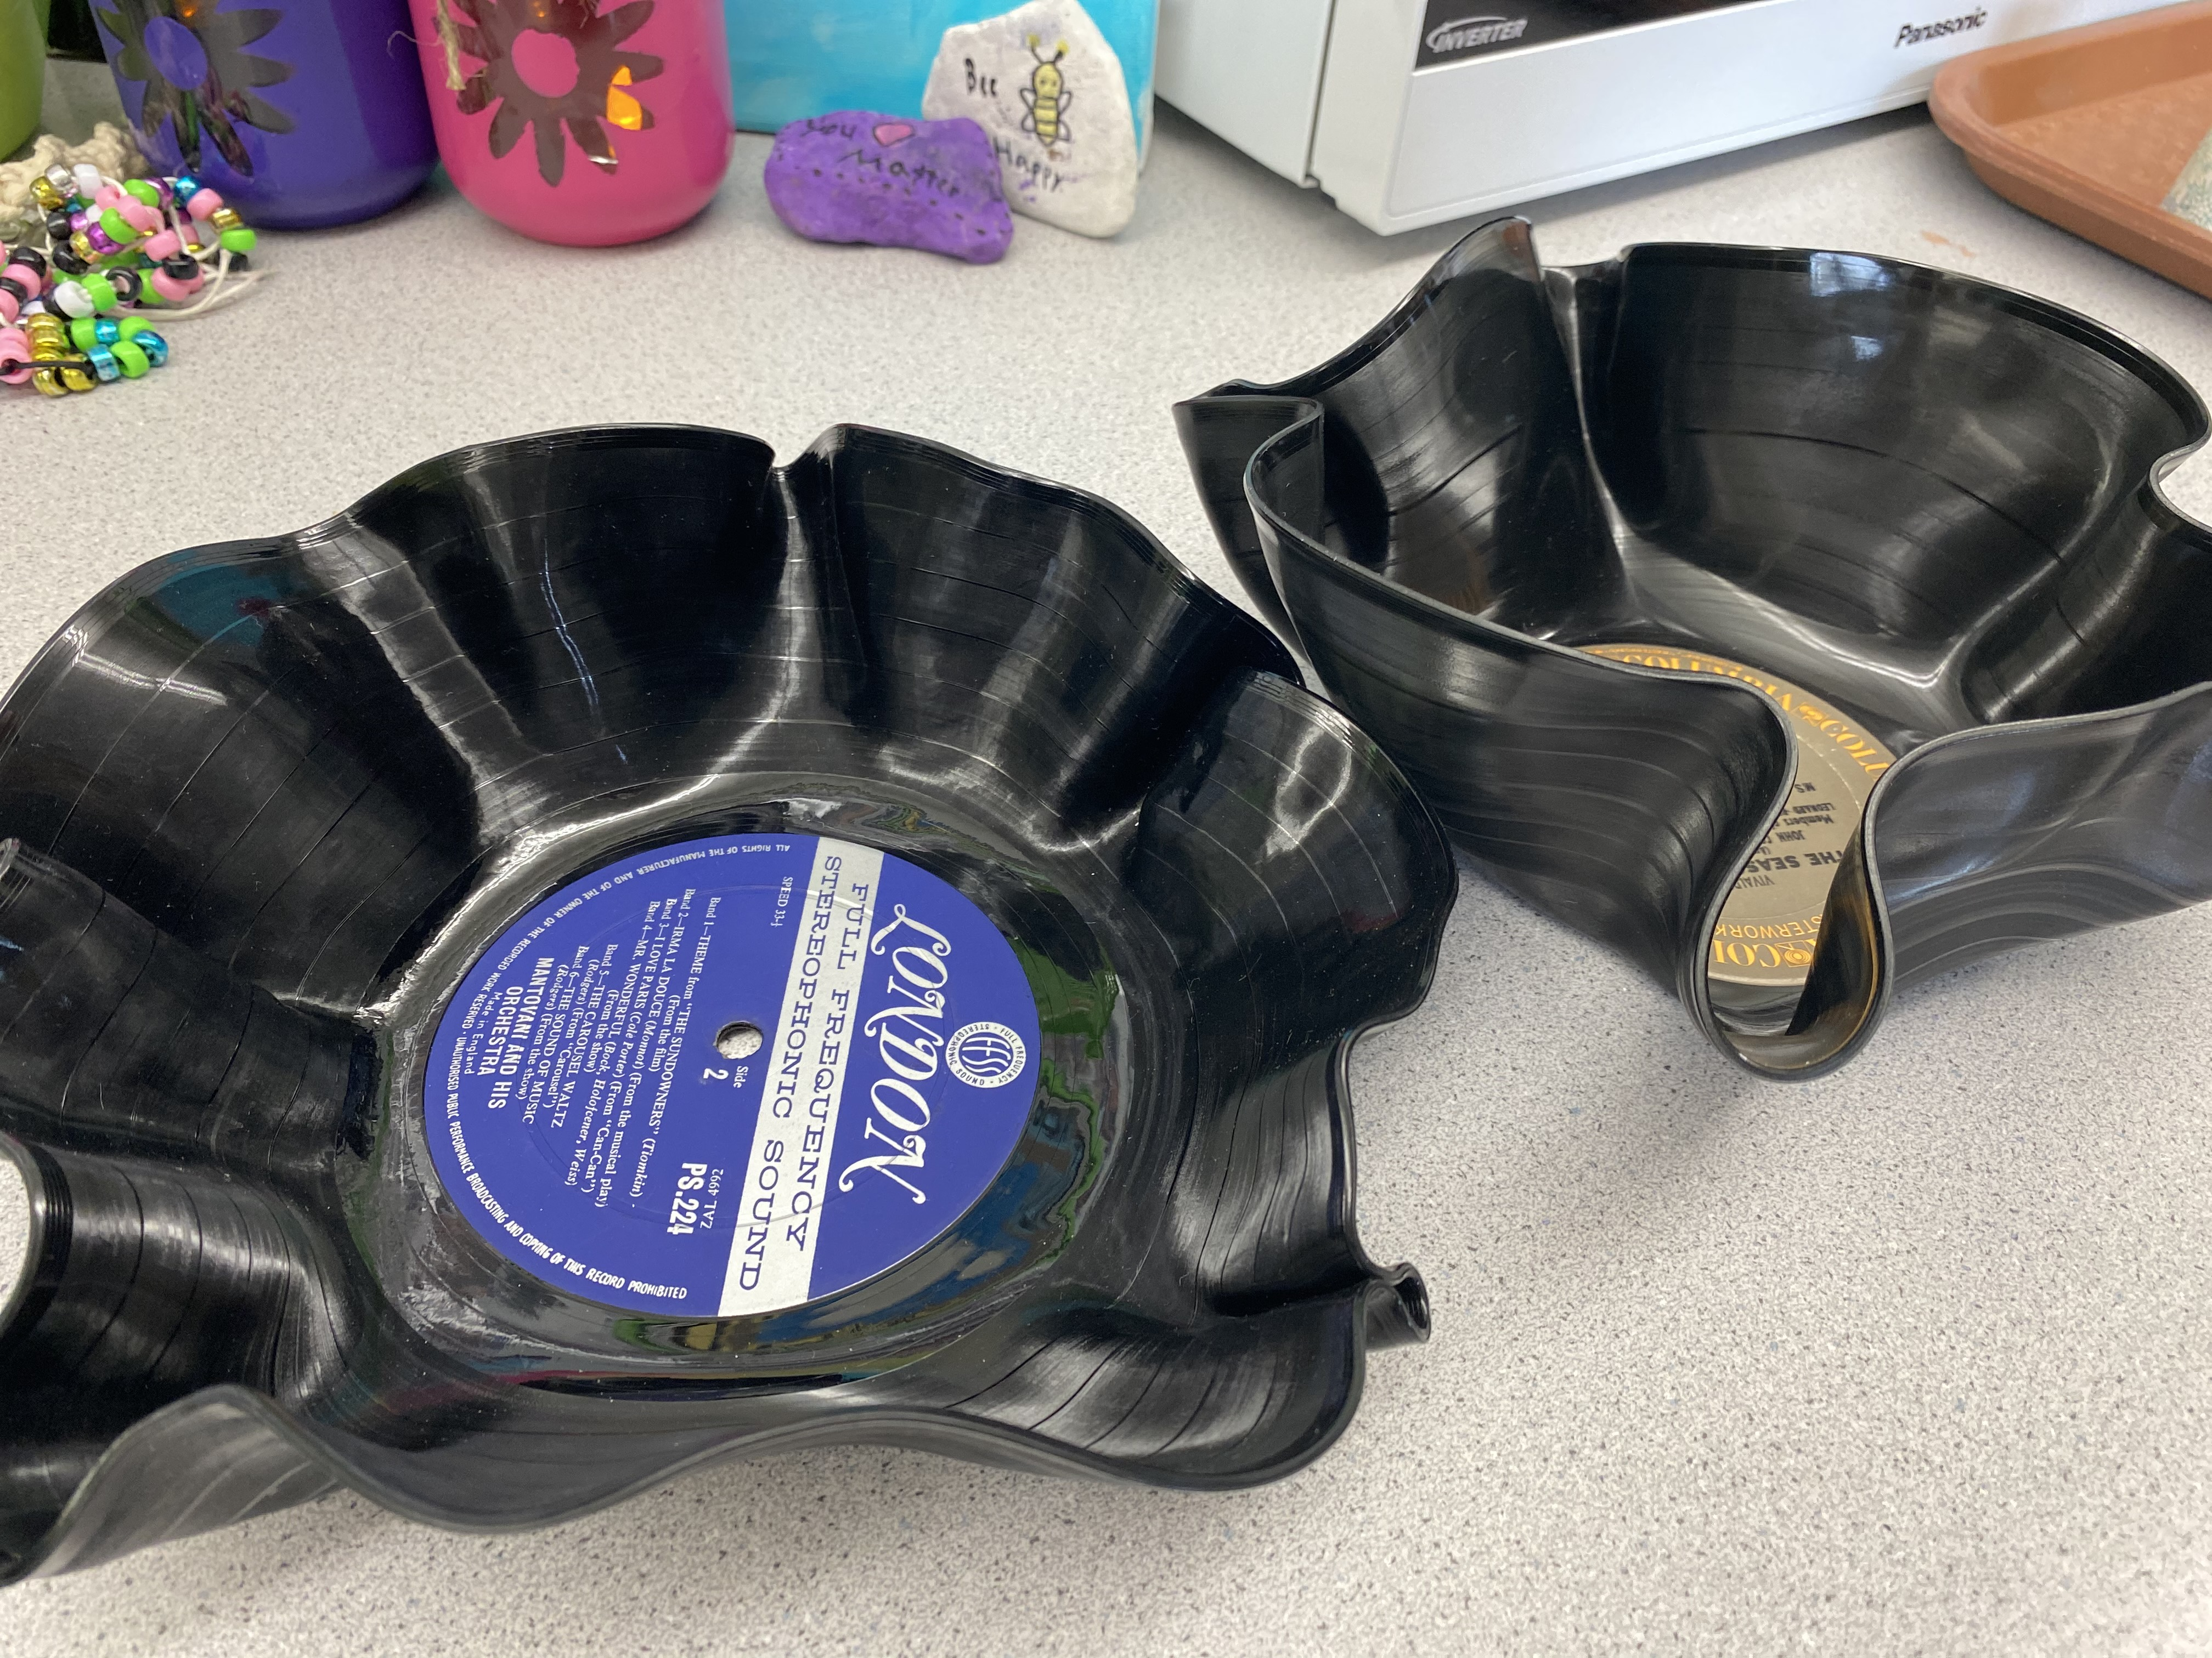
Lilie’s Catch-All Record Bowls
$8.00 each
40 available
https://anglophonewest.schoolcashonline.com/Fee/Details/24874/176/False/True

Slide 6
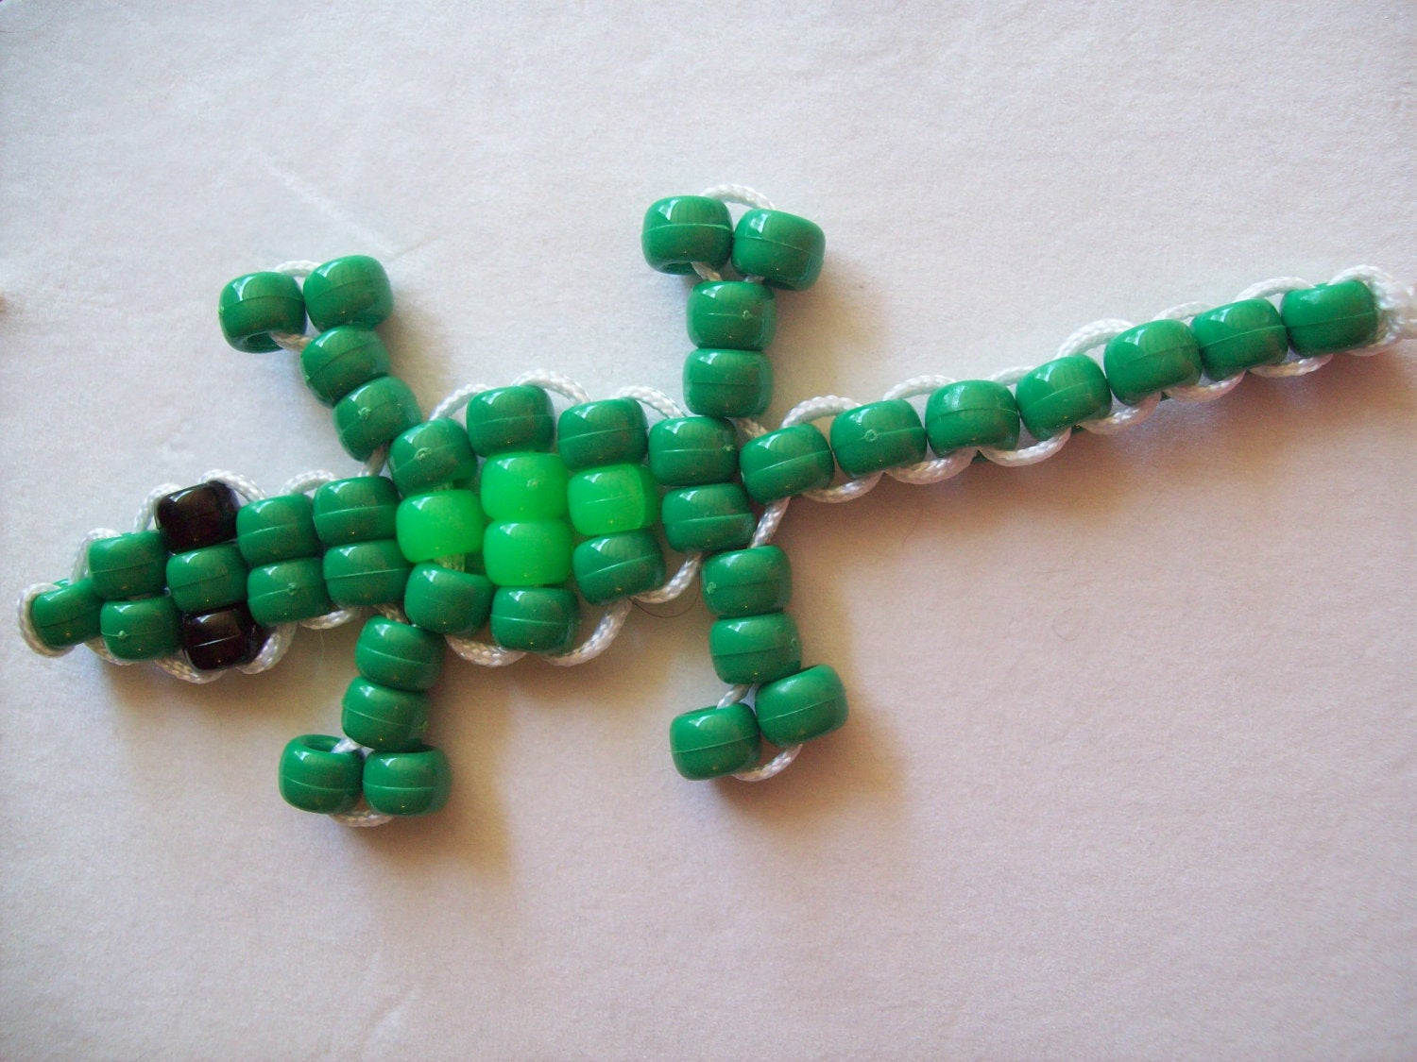
Tiona and Piper’s Lizard Bead Key Chains
$5.00 ea.
10 available
https://anglophonewest.schoolcashonline.com/Fee/Details/24885/176/False/True

Slide 7
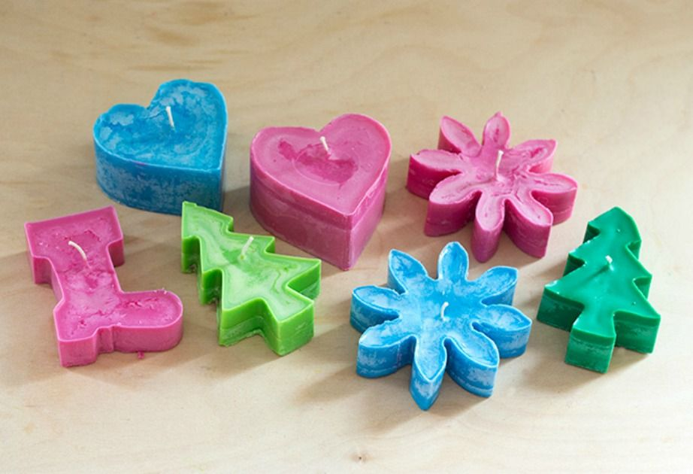
Hunter’s Scented Crayon Candles
Various colours and shapes; lightly scented
$4.00 ea.
15 available
https://anglophonewest.schoolcashonline.com/Fee/Details/24892/176/False/True

Slide 8
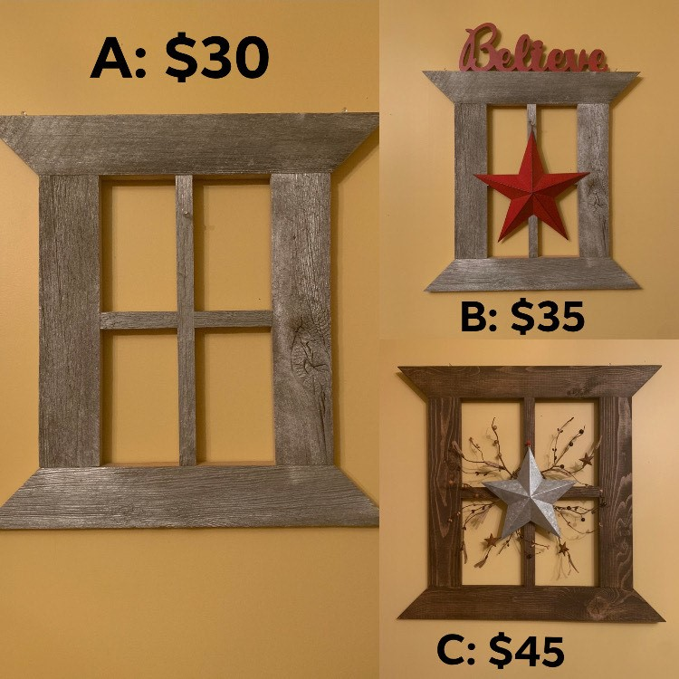
Janeya’s Primitive Window Wonders
*Prices on Photo
*Three available per style
*25x20 inches
https://anglophonewest.schoolcashonline.com/Fee/Details/24894/176/False/True

Slide 9
Tiona & Piper’s Beaded Key Chains $4.00 ea. 20 available
https://anglophonewest.schoolcashonline.com/Fee/Details/24897/176/False/True

Slide 10
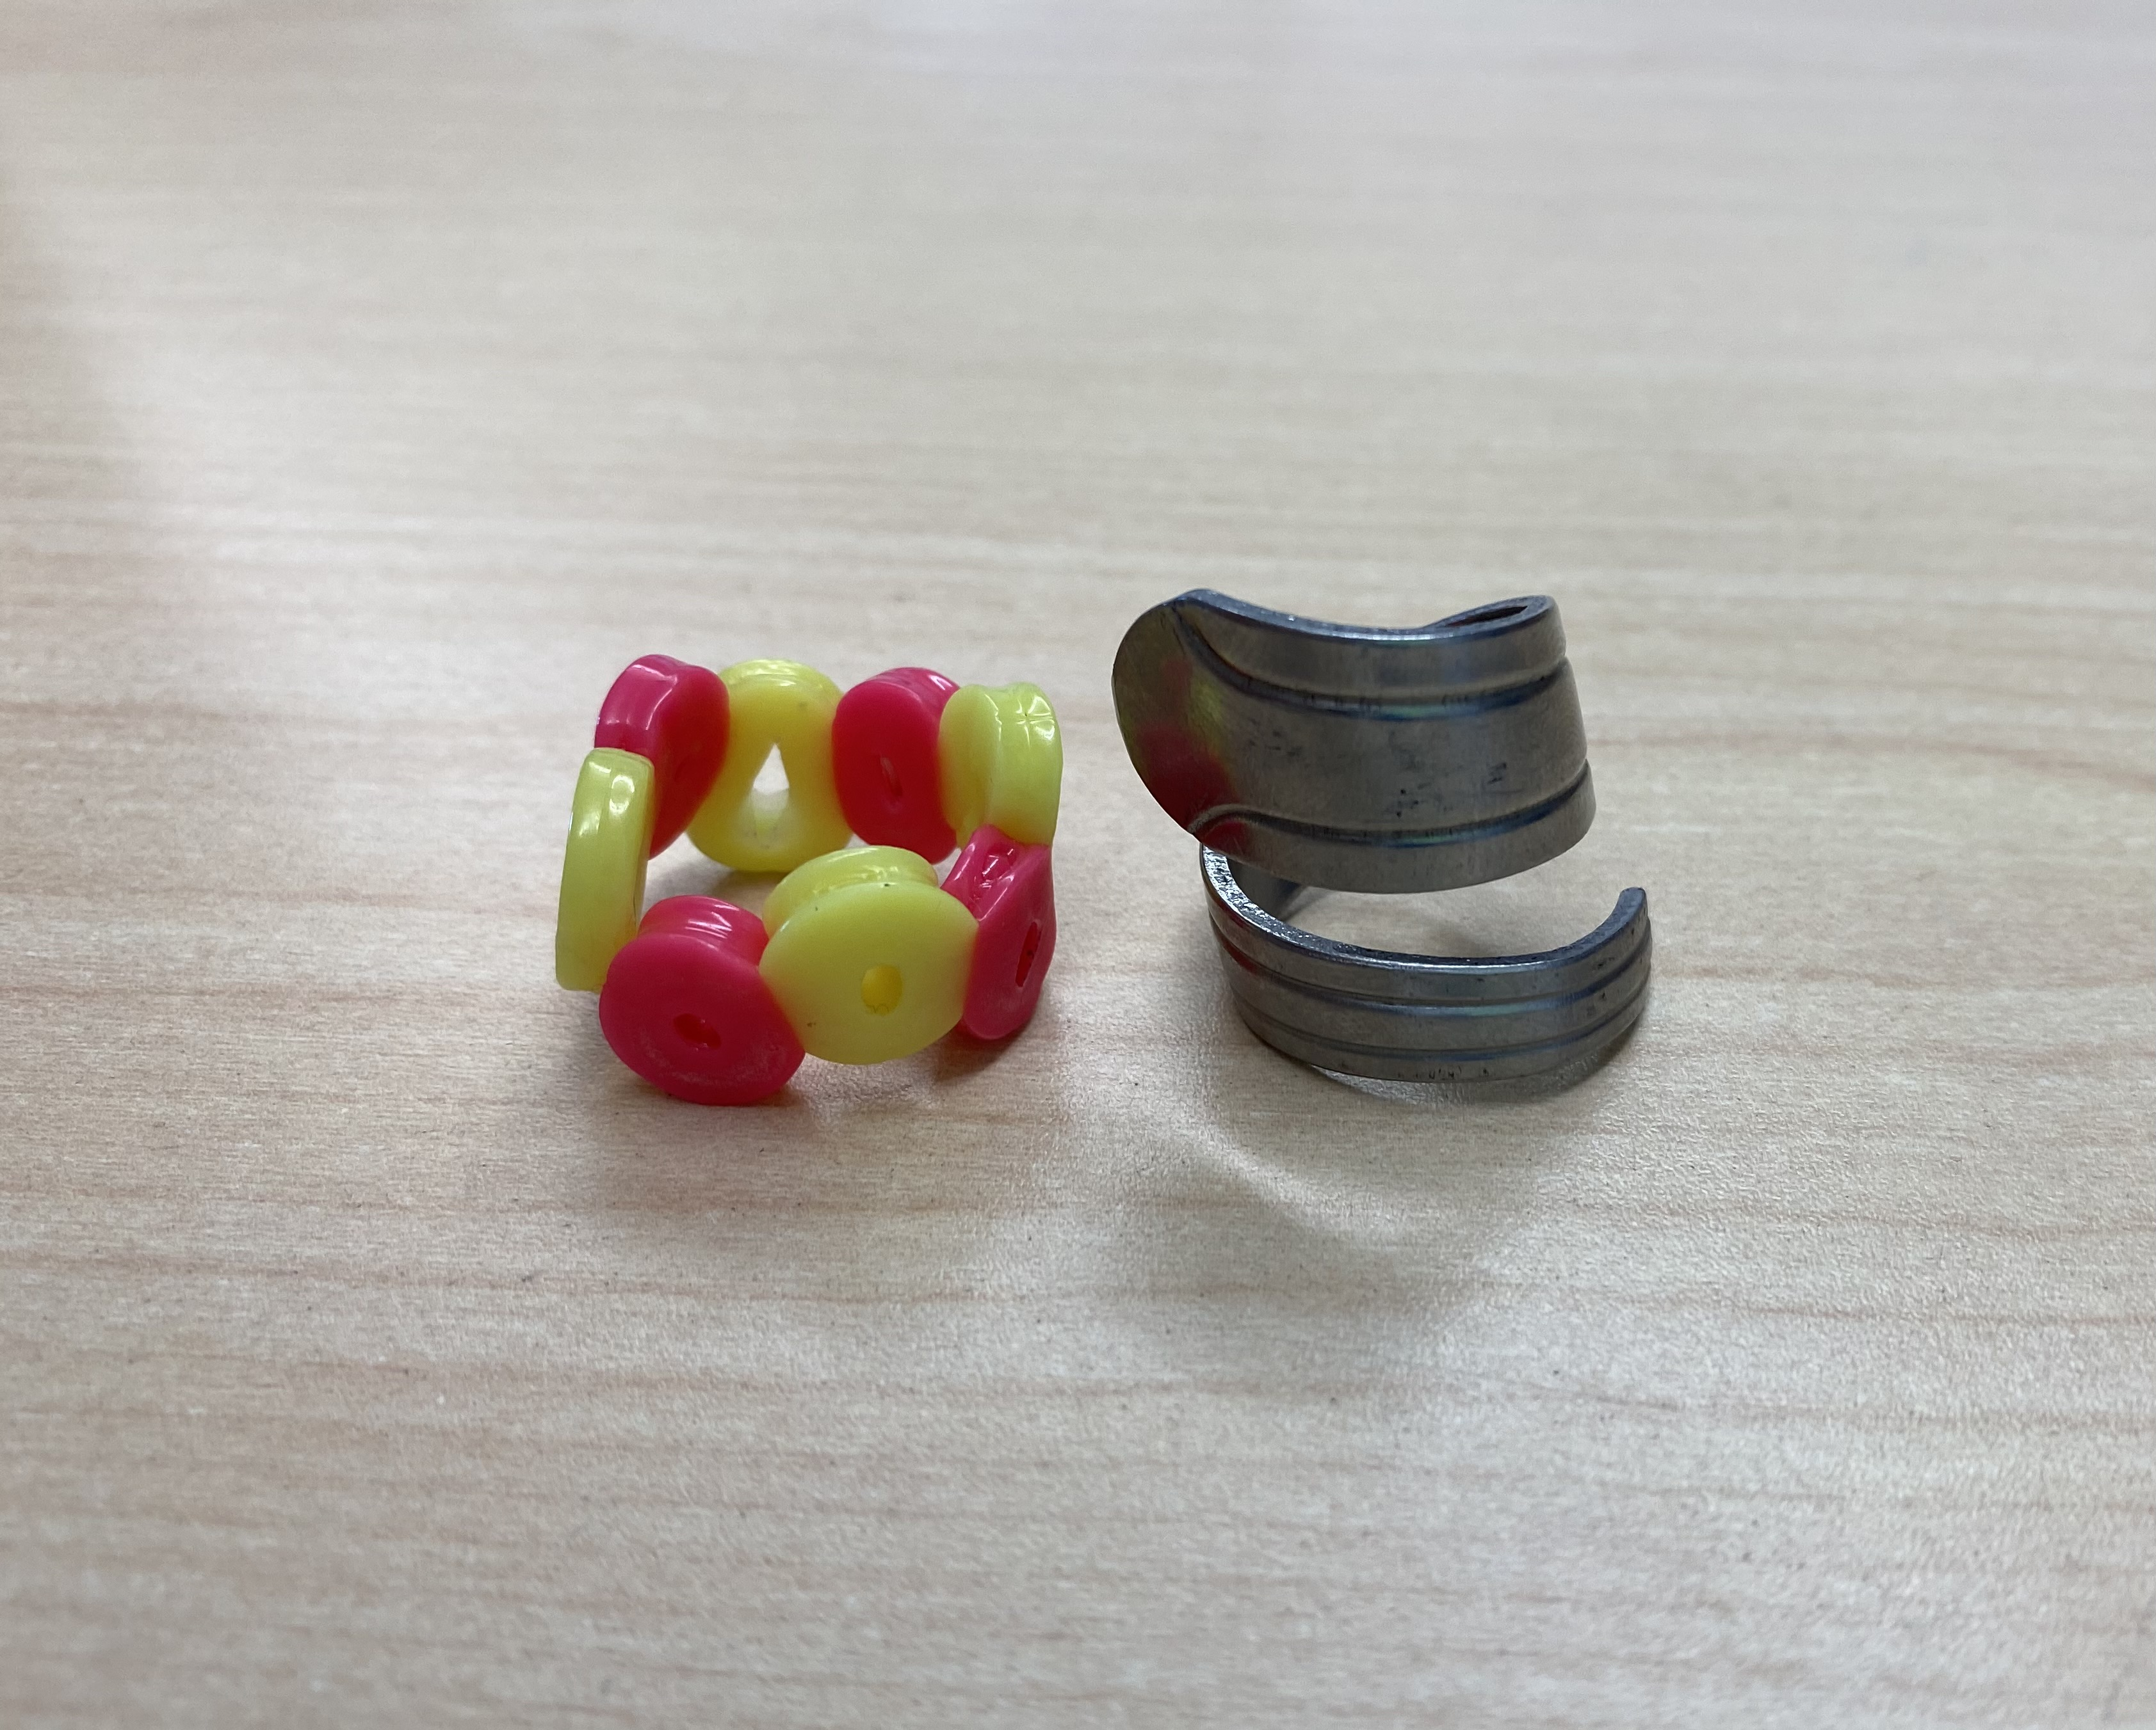
Karamia and Emily’s Rings & Things! $5.00/beaded Ring (10 available) $10 Stainless Steel Spoon Ring (10 available)
https://anglophonewest.schoolcashonline.com/Fee/Details/24901/176/False/True

Slide 11
Bryson’s Personalized Tumblers $20 ea. (up to ten characters per name) 70 available! These tumblers change colour! (straw not included)
https://anglophonewest.schoolcashonline.com/Fee/Details/24903/176/False/True

Slide 12
Bryson’s Key Chains choose from: *Names (up to ten letters) *Minecraft *Fortnite *Cats *Dogs $4.00 each 50 available
https://anglophonewest.schoolcashonline.com/Fee/Details/24904/176/False/True

Slide 13
Abigail’s Frames of Love (8x10) $5.00 ea. 10 available
https://anglophonewest.schoolcashonline.com/Fee/Details/24907/176/False/True

Slide 14
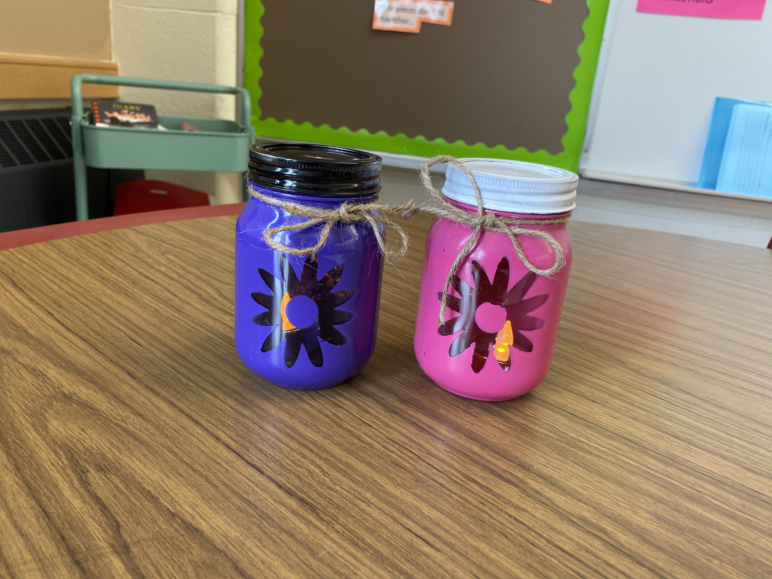
Renee’s Rustic Candle Jars
Pink or Purple: light included!
$10 ea.
20 Available
(ten per colour)
https://anglophonewest.schoolcashonline.com/Fee/Details/24908/176/False/True

Slide 15
Ella & Olivia’s Homemade Masks $10 ea. 10 Available; style and materials will vary
https://anglophonewest.schoolcashonline.com/Fee/Details/24919/176/False/True

Slide 16
Ethan’s Washer Toss Kits $30.00 10 available colours may vary
https://anglophonewest.schoolcashonline.com/Fee/Details/24920/176/False/True

Slide 17
Addy’s Monster Pots 3-inch diameter $5.00 ea. 10 available
https://anglophonewest.schoolcashonline.com/Fee/Details/24943/176/False/True

Slide 18
Summer and Madi’s Scented Surprise! Candles Bubblegum & Root Beer Scent $4.00 ea. 15 available per scent
https://anglophonewest.schoolcashonline.com/Fee/Details/24945/176/False/True

Slide 19
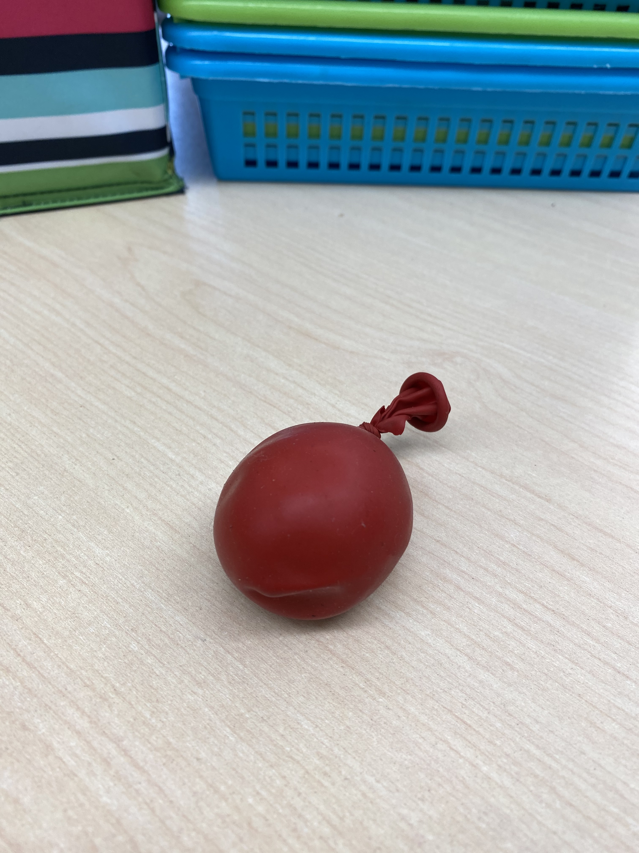
Susie’s Stress Balls
$1.00 each
Ten available
https://anglophonewest.schoolcashonline.com/Fee/Details/24947/176/False/True

